Slide 1
Machine Learning
Machine Learning Introduction to Machine Learning by Kumar Anurupam is licensed under a Creative Commons Attribution-4.0 International License.
Gaussian Mixture Model - Introduction
CS 3104 Fall 2019
Lecture Slides by Kumar Anurupam
Courtesy: Slides taken from NPTEL video on GMM using EM Technique by Prof. Sukhendu Das, IIT Madras

Slide 2
Learning Objectives
After completion of today’s session you will be able to:
Explain the concept of Gaussian Distribution.
Elaborate the idea of Gaussian Multivariate Model.
Derive the parameter estimation in Gaussian Multivariate Model.

Slide 3
Gaussian Mixture Model
A mixture model is a probabilistic model for representing the presence of subpopulations within an overall population.
GMM is a type of unsupervised learning algorithm.
It can be used for:
Anomaly detection
Customer behavior prediction
Speech Recognition

Slide 4
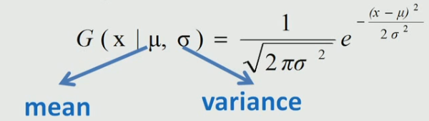
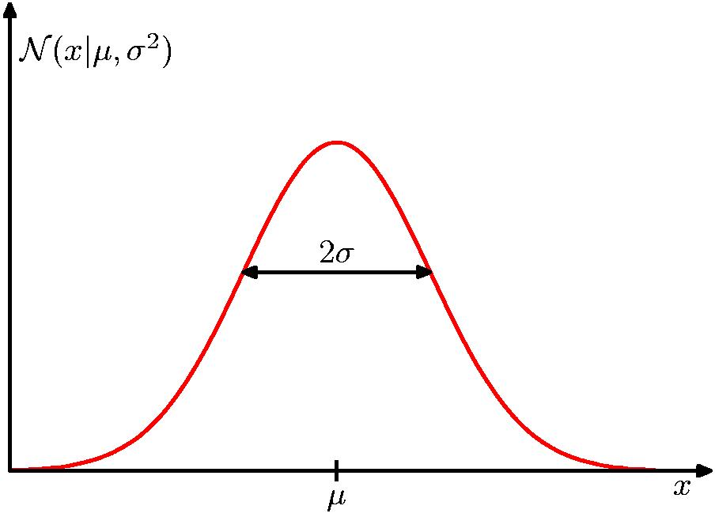
The Gaussian(Normal) Distribution - recap
Distribution: A distribution is a listing of outcomes of an experiment and the probability associated with each outcome.
Probability density function is a function of a continuous random variable, whose integral across an interval gives the probability that the value of the variable lies within the same interval.
For a single variable(Univariate), the normal probability density function is:

Slide 5
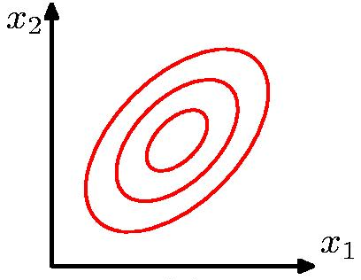
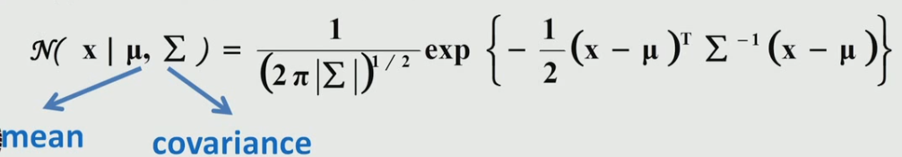
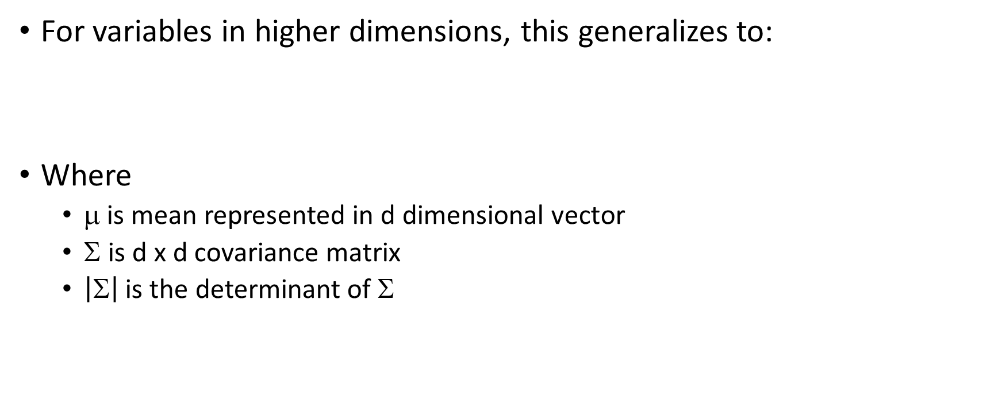
Gaussian Multivariate Distribution
For variables in higher dimensions, this generalizes to:
Where
μ is mean represented in d dimensional vector
Σ is d x d covariance matrix
$\left|\text{S}\right|$ is the determinant of Σ

Slide 6
Parameter Estimation
In case of higher dimensional data there is a challenge to find out the parameters (Σ, μ).
This can be achieved by a technique called Maximum Likelihood(ML) Estimation.

Slide 7
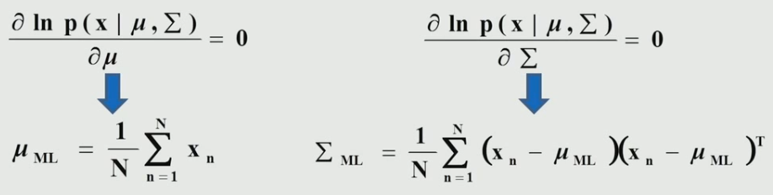
ML method for estimating parameters
Taking log of the Gaussian Distribution, we get
Take the derivative and equate it to zero. This is done for maximizing.
Where, N is the number of sample or data points

Slide 8
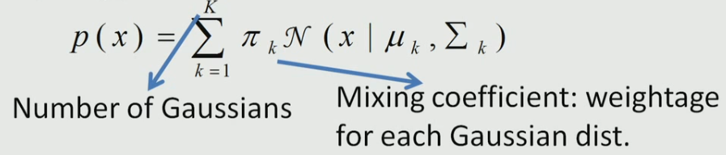




Gaussians Mixtures
Gaussian mixture distribution can be written as a linear superposition of Gaussians in the form:
Taking log-likelihood:
Where:
N = Number of samples
K = Number of Gaussians

Slide 9
Improving the approach
The above formula may not work properly because it only analyzes the condition once that is there is no closed form solution.
Therefore, we need an iterative approach to calculate the parameters.
This approach is known as Expectation Maximization(EM) Technique.

Slide 10
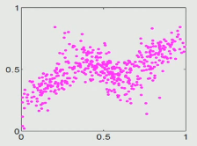
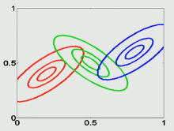
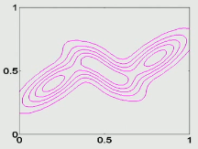
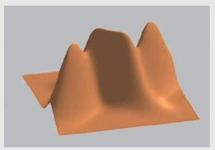
Example: Mixture of 3 Gaussians
How can we determine how many number of Gaussians(K) required?
We can’t model these using a single Gaussian and therefore multiple(or mixture) Gaussians are required

Slide 11
References
[1] http://research.microsoft.com/~cmbishop/PRML/index.htm
[2] Book: Pattern recognition and Machine Learning, C . M. Bishop, Springer, 2006
[3] https://towardsdatascience.com/gaussian-mixture-models-explained-6986aaf5a95

Slide 12
Thanks

